Slide 1
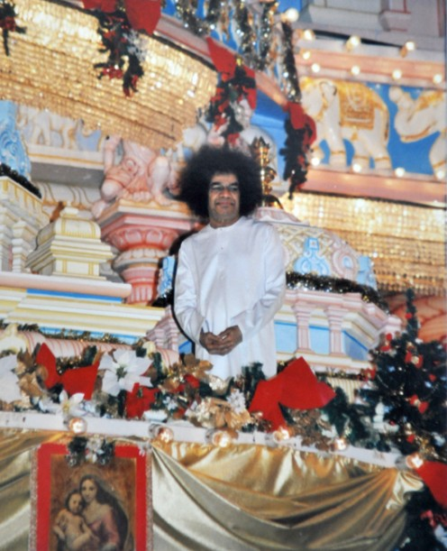
Christmas
&
Hanukkah
Celebrations!
Sri Sathya Sai Baba Center of
Central San Jose
December 21, 2014

Slide 2

Trivia Questions: Christmas
In the 1972 Christmas Discourse Swami said that Jesus Christ made an announcement about the Advent of Baba by declaring: "He who sent me among you will come again! His Name will be _________." What Name did Jesus prophesize?
A. Baba [Divine Father].
B. Sai [Divine Mother].
C. Sathya [Truth].
D. Prema [Love].

Slide 3
Trivia Questions: Christmas
A: C - Sathya [Truth]. Swami said: "The statement of Christ is simple: 'He who sent me among you will come again!' and he pointed to a Lamb. The Lamb is merely a symbol, a sign. It stands for the Voice - Ba-Ba; the announcement was the Advent of Baba. 'His Name will be Truth,' Christ declared. Sathya means Truth. 'He will wear a robe of red, a blood red robe.' (Here Baba pointed to the robe He was wearing!). 'He will be short, with a crown (of hair). The Lamb is the sign and symbol of Love.'

Slide 4

Trivia Questions: Hanukkah
In what order do you light the candles on a Menorah?
A: From left to right

Slide 5
Trivia Questions: Christmas
What did the three Kings bring to Jesus when he was born?
A: Gold, Frankincense and Myrrh

Slide 6
Trivia Questions: Hanukkah
What is a menorah?
A: Menorah is a ceremonial candle holder used in Jewish celebrations. Initially there were 7-branched candle holders and now most temples use 9-branched candle holders.

Slide 7
Trivia Questions: Christmas
How many angels spoke to the shepherds when Jesus was born?
A: Only one

Slide 8
Trivia Questions: Hanukkah
What does “Hanukkah” mean?
A: “Hanukkah” means “re-dedication”

Slide 9
Trivia Questions: Christmas
Which star led the three Kings to Jesus?
A: The star of Bethlehem

Slide 10
Trivia Questions: Hanukkah
For how many days is Hanukkah celebrated?
A: Eight days

